Slide 1
Distributed Logistics in an Urban Setting Using Small Unmanned Aerial Vehicles
Team Lakshya-IISc
Faculty Advisors:
Prof. Ranjan Ganguli
Prof. Dineshkumar Harursampath
Dr. S N Omkar
Department of Aerospace Engineering
Indian Institute of Science, Bangalore-560012

Slide 2
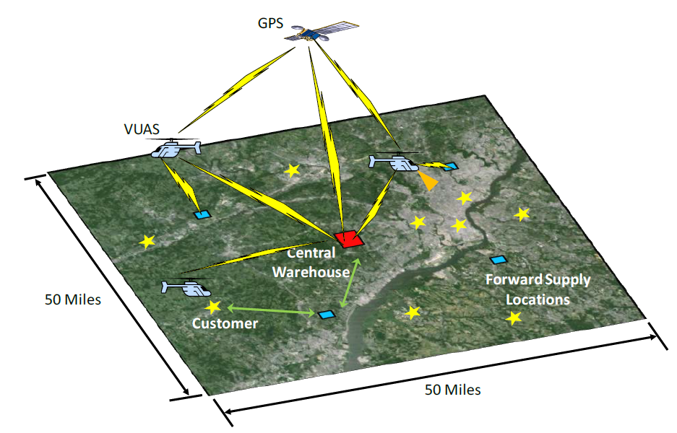
Problem Statement for Graduate Teams
Overall concept of operations

Slide 3
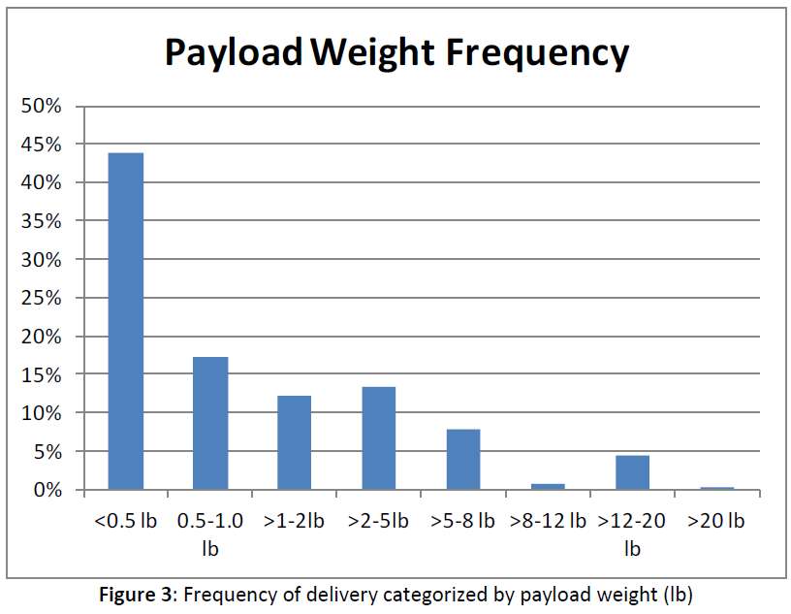
Problem Statement for Graduate Teams
Payload information
90% payload volume: 12 X 12 X 16 cubic inches
External slung load delivery for larger shipments

Slide 4
Cargo, Customers & Shipments
Even distribution of customer locations
5000 packages per day in 10 hours delivery time
Shipment within 120 minutes
Uniformly random fashion of request from customers within first 8 hours

Slide 5
System design questions
More than 1 vehicle design?
Maximum payload and range of each vehicle design?
Operating locations (FSL) other than Central Warehouse? Role?
RUAV automation technology required for “delivery to the door”?
Hybrid propulsion or power source or power augmentation?
Design for repair vs. design for inexpensive part replacement?
Acquisition, and operating cost of RUAVs for 3 years.

Slide 6
Data Deliverables
Proposed concept of operations
Detailed performance analysis of the designed RUAV
General description of the RUAV with 3-view drawings of major components
Mission performance summary: flight speed, energy consumed, power required
Detailed weight statement of the RUAVs with analysis
Turnaround timeline & lifecycle cost estimate
Probability of package delivery in 2 hours
Prediction of acoustic signature of the RUAVs as per FAA flyover rules

Slide 7
Measures of Effectiveness
System acquisition and yearly operating costs
Number of packages delivered per vehicle per day
Number of shipments with delivery time > 90 minutes
Pounds of CO₂ emitted/delivery mile flown (daily average)
% of shipments delivered successfully

Slide 8
Concept of Operation
Delivery area divided into (at least) 5 zones; with one FSL in each zone
FSLs – acts as the nodal point for each zone - temporary storage location for most likely packages for particular zone - transit point; refueling/recharging station; maintenance/repair, etc.

Slide 9
Concept of Operation
Two RUAV designs considered: 1. Helicopter – heavier packages; transport packages from CW to FSL 2. Quad-copter – for lighter packages; delivers packages to customer location
Helicopter: advanced configuration based on Yamaha R-MAX design modified to suit the mission requirements for the SDC

Slide 10
Yamaha R-MAX RUAV
Cruise speed ~ 20 km/hr
Endurance ~ 1 hour
Specification | Value
Main rotor diameter | 3115 mm
Tail rotor diameter | 545 mm
Number of blades | 2
Empty weight + fuel | 64 kg
Payload capacity | 30 kg
Engine output | 15.4 KW
Overall length | 3630 mm
Overall height | 1080 mm
Overall width | 720 mm

Slide 11
Performance Analysis
Selection of baseline helicopter based on mission requirements: Yamaha R-MAX
Helicopter design objective:
Efficient hover performance
Efficient forward flight (cruise speed) performance
Taguchi method of robust design methodology for main rotor design
Design parameters:
Main rotor blade length
Plan-form variation (blade taper)
Rotor speed
Span-wise distribution of blade pre-twist

Slide 12
Performance Analysis
Result of robust design using Taguchi method for hover performance:
Main rotor radius: 1.75 m
Rotor speed : 800 rpm
Blade plan-form : Tip chord length = 0.08 m Root chord length = 0.12 m
Blade pre-twist : 10 degrees

Slide 13
Future Work
Robust design for forward flight (cruise speed of Yamaha R-MAX)
Associated ANOVA studies
Detailed performance analysis of modified R-MAX configuration: - performance studies for main rotor - power requirements of tail rotor - total power estimate considering drag due to fuselage, slung load, etc.

Slide 14
Thank You

Slide 15
Timeline
Project delegation
Design Specs
Design Specs
Hardware validation
Begins
Path Planning Algorithm
RUAV Performance Analysis
RUAV Structural Analysis
RUAV Performance Analysis
Optimal Path Planning Algorithm
GPS based RUAV tracking
Additive manufacturing: 3D printing
Demonstration of single (or multiple)
RUAV following an optimal path.
Begins: Final Draft report
Draft paper
Timeline
9 February
03 March
03 April
03 May 2015
29 May 2015
October 2015
Phase 1 Here
Phase 2 Here
Phase 3 Here
Phase 4 Here
Phase 5 Here
03 May 2015
December 2015
9 Feb 2015
First draft of Final Proposal
Extended draft paper for Journal
Letter of Intent
29 May 2015
03 April 2015
Final Submission:
1) Final Proposal;
2) Executive Summary
3) Demonstration of hardware validation (video file)
October 2015
Hardware Validation
(Pre-test predictions) Submission
Draft paper for AHS Forum 2016 and AIAA 2016 conferences

